Slide 1

Performance Optimization of Multi-Stage Queue System
Ben-Gurion University of The Negev
Computer Networks Design - 371.1.0281
Maya Simhi
Dolev Eisenberg

Slide 2
01
Introduction
Background and Overview of the project
02
Simulation Setup
Table of Contents
Modules design, simulation design, statistics collection
03
Static Simulation Results
Normal & busy load-balancing
04
Dynamic Simulation Results
Linear Increase, Hysteresis Decrease
Queue Drain-time Estimation
05
Conclusions
Comparisons and insights

Slide 3
Introduction
d

Slide 4
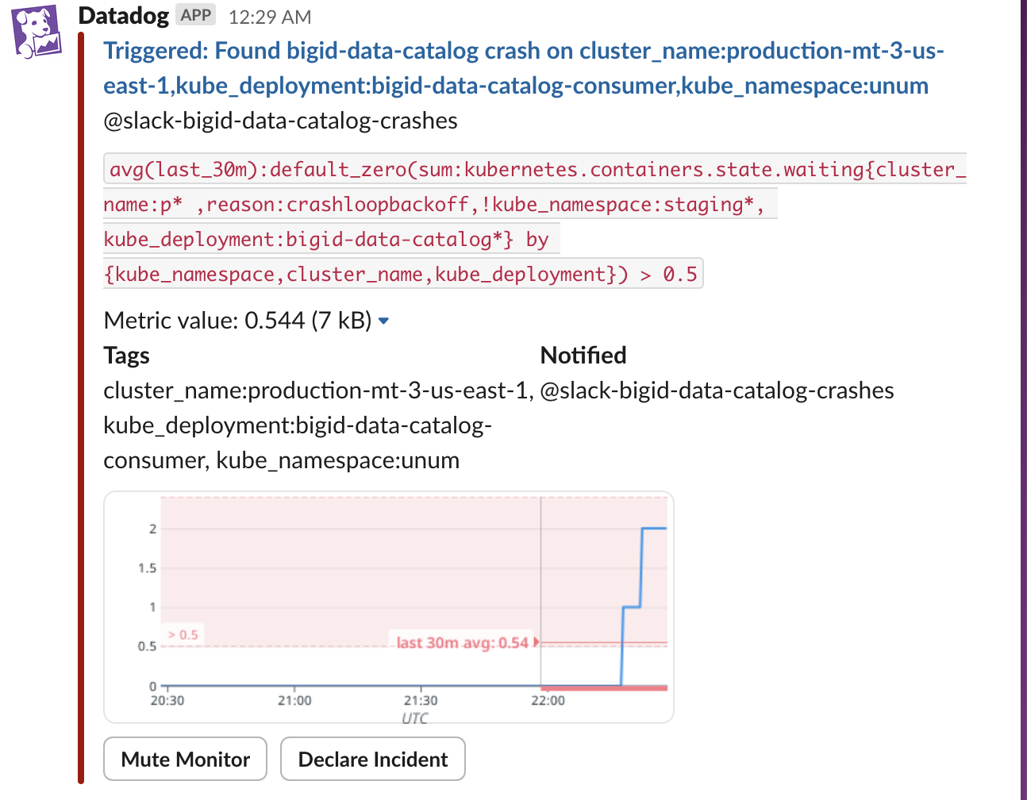
Introduction - Background
Inspired by real-world System
3-Stage Processing of customer data for data security, regulations etc.
Messages handled in queues using RabbitMQ
Load surges result in full system crash

Slide 5
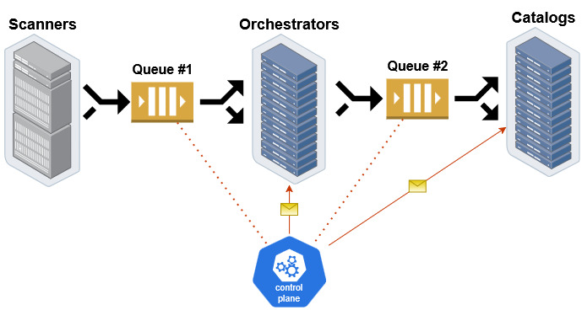
Introduction – System Model
Scanners
Orchestrators
Catalogs
Queues
Control plane
Generate jobs based on client data
Initial assignment & pre-processing
Main processing
buffers between the stages of the system
Oversees load balancing by opening/closing further units
Overflowing results in system crash
retire jobs at completion
Arrival is modeled as Poisson Process

Slide 6
Introduction – Project Overview
Model the system within OMNeT++
Find optimal static balancing of the system
Under moderate and heavy load
Evaluate dynamic balancing alternatives
Test different controller algorithms
Find optimal settings using parameter sweeps
Compare best results

Slide 7
Simulation Setup
d

Slide 8
Network Design
6 OMNeT modules
Queue
Scanner
Orchestrator
Catalog
Controller
StatsCollector
Dedicated message entry (Job.msg)
Storing instantiation time, queue arrival time & queue latency
Two .ned network configurations
StaticNetwork.ned
DynamicNetwork.ned
Hierarchical INI file
each simulation has a base config
Dedicated configurations for each scenario

Slide 9
Module Design
Bounded queue module with internal processing time, able to process one job at a time
Simulates software delays when inserting to queue
Initialization: register signals (statistics), load parameters, establish interface with StatsCollector module
Pop job from queue: public method, called by ‘pulling’ class
GUI shows number of jobs in queue
Upon receiving a message
Self message finished internal-processing, insert job to queue
External module New job arrives at the queue
Check if queue isn’t full
Full - Drop the message
Not full - update arrival time within job, hold it in buffer and send self-message
Queue
Scanner
Controller
Config
Orchestrator & Catalog
Stats Collector

Slide 10
Module Design
Generates jobs as a Poisson Process with rate 0.1 sec (defined by parameter interArrivalTime)
Creates jobs via self-message every Poisson ‘tick’
Sends new jobs to queue
Multiple Scanners (constant per each simulation)
GUI method displaying number of jobs generated
Queue
Scanner
Controller
Config
Orchestrator & Catalog
Stats Collector

Slide 11
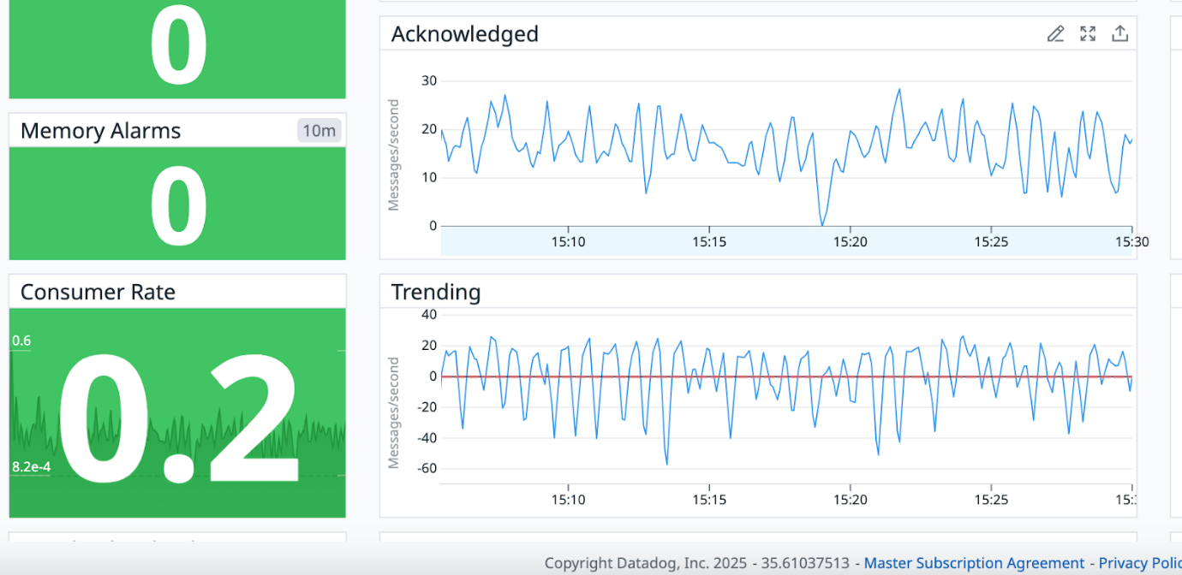
Module Design
Process one job at a time over exponential rate - 0.25 sec (Orch.), 5 sec (Catalog)
Can receive control messages – enable/disable unit (individually)
Manages jobs using inner-buffer and self messages
“End processing” – finished processing a job, send it to next queue (if Orch.) or retire the job (if Catalog)
“poll queue” – free to work, try to fetch a job from the previous queue
If queue is empty – keep polling it in a stochastic rate
GUI updates successful pulling from queue (using bubble), color-coded status:
Red – unit is disabled
Orange – Unit enabled & currently processing
Green – Idle
Queue
Scanner
Controller
Config
Orchestrator & Catalog
Stats Collector

Slide 12
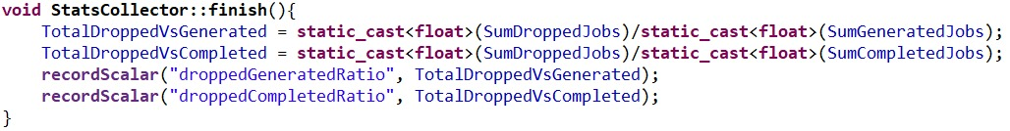
Module Design
Problem: large number of active modules, each generating statistics independently
Many statistics have little standalone meaning
Require significant post-processing to extract meaningful insights
Simulation output can reach multiple GBs
Solution: A dedicated Statistics collection module
Individual modules call public methods within, aggregating results
Final processing performed at simulation end (using finish() method)
Statistics are concise & meaningful
Significantly reduce data output size
Additionally, we further parsed the raw data (as csv) within Python (using Pandas)
Queue
Scanner
Controller
Config
Orchestrator & Catalog
Stats Collector

Slide 13
Module Design
Samples the queues in the system every X seconds
Using public method in Queue class
Sends self-messages at X [sec] intervals
Calculates desired number of active Orch./Catalogs (individually)
According to selected function & parameters
Sends enable/disable messages to units
Tracks full statistics over behavior and changes in the system
2 approaches (functions) tested
Linear Ramp-up, Averaged Decay
Queue Drain-Time Estimation (QDTE)
Queue
Scanner
Controller
Config
Orchestrator & Catalog
Stats Collector

Slide 14
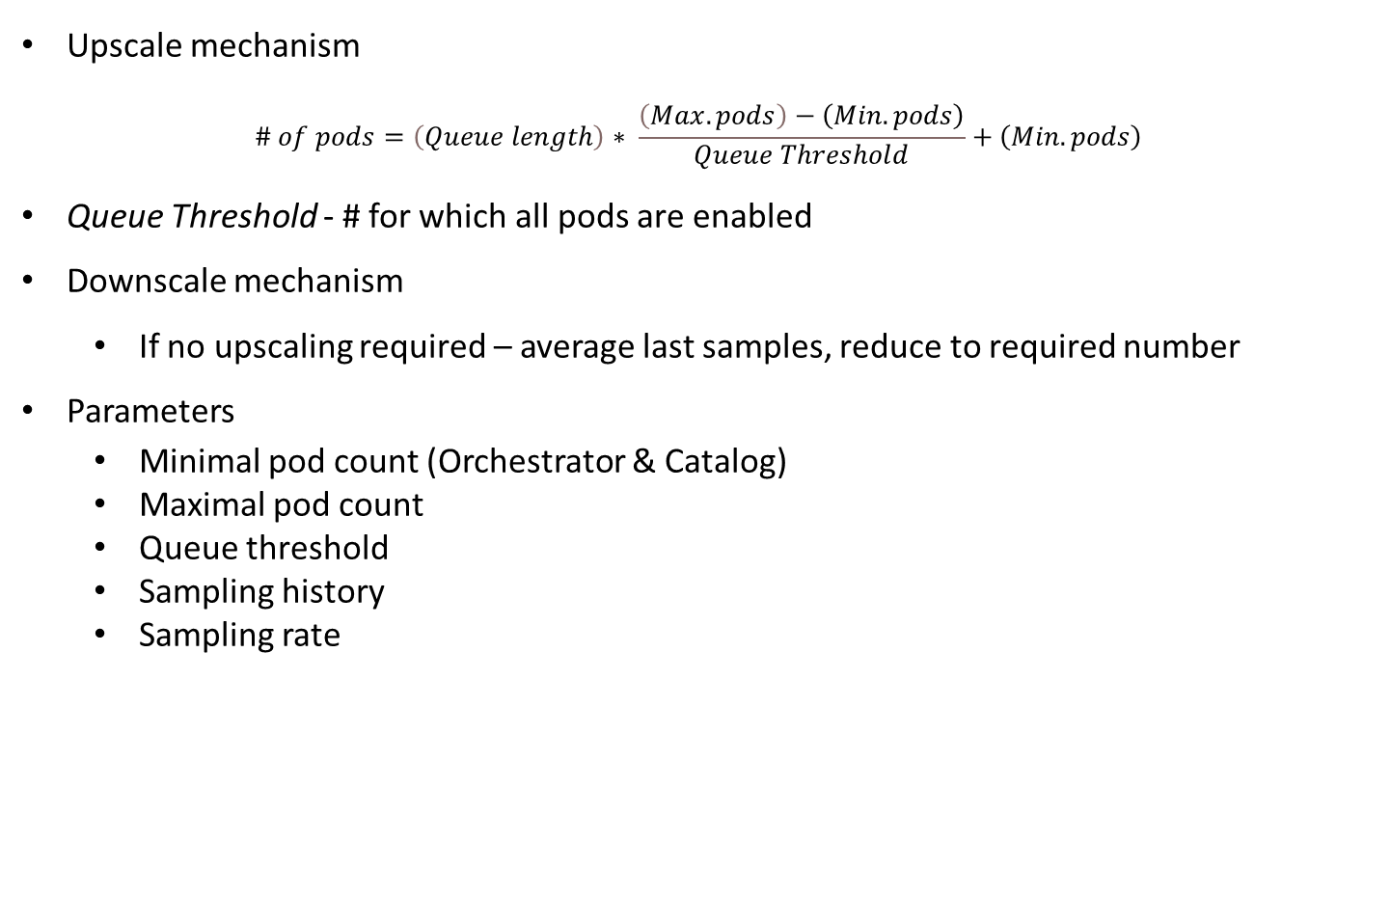
Linear Ramp-up, Averaged Decay
Upscale mechanism
$$\# of pods=\left(Queue length\right)∗ \frac{\left(Max. pods\right)−\left(Min. pods\right)}{Queue Threshold}+\left(Min. pods\right)$$
Queue Threshold - # for which all pods are enabled
Downscale mechanism
If no upscaling required – average last samples, reduce to required number
Parameters
Minimal pod count (Orchestrator & Catalog)
Maximal pod count
Queue threshold
Sampling history
Sampling rate
Queue
Scanner
Controller
Config
Orchestrator & Catalog
Stats Collector

Slide 15
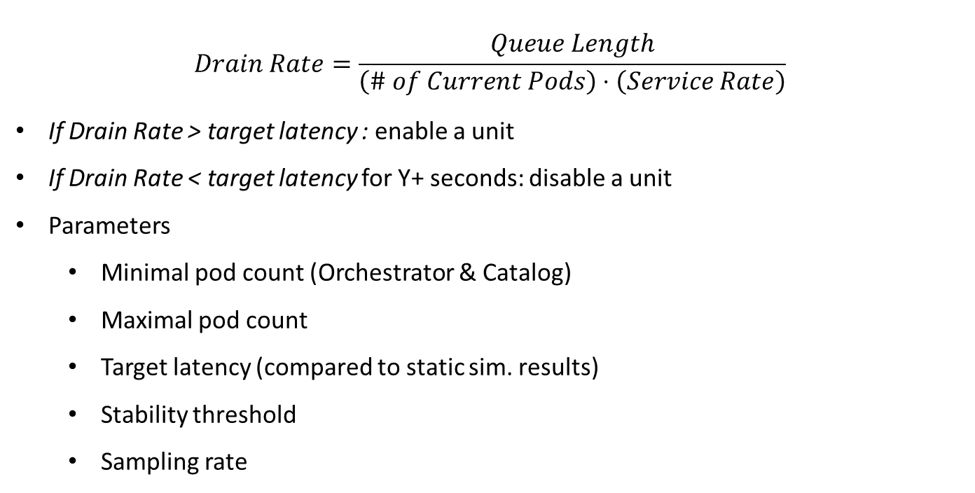
Queue Drain-Time Estimation (QDTE)
$$Drain Rate=\frac{Queue Length}{\left(\# of Current Pods\right)⋅\left(Service Rate\right)}$$
If Drain Rate > target latency : enable a unit
If Drain Rate < target latency for Y+ seconds: disable a unit
Parameters
Minimal pod count (Orchestrator & Catalog)
Maximal pod count
Target latency (compared to static sim. results)
Stability threshold
Sampling rate
Queue
Scanner
Controller
Config
Orchestrator & Catalog
Stats Collector

Slide 16
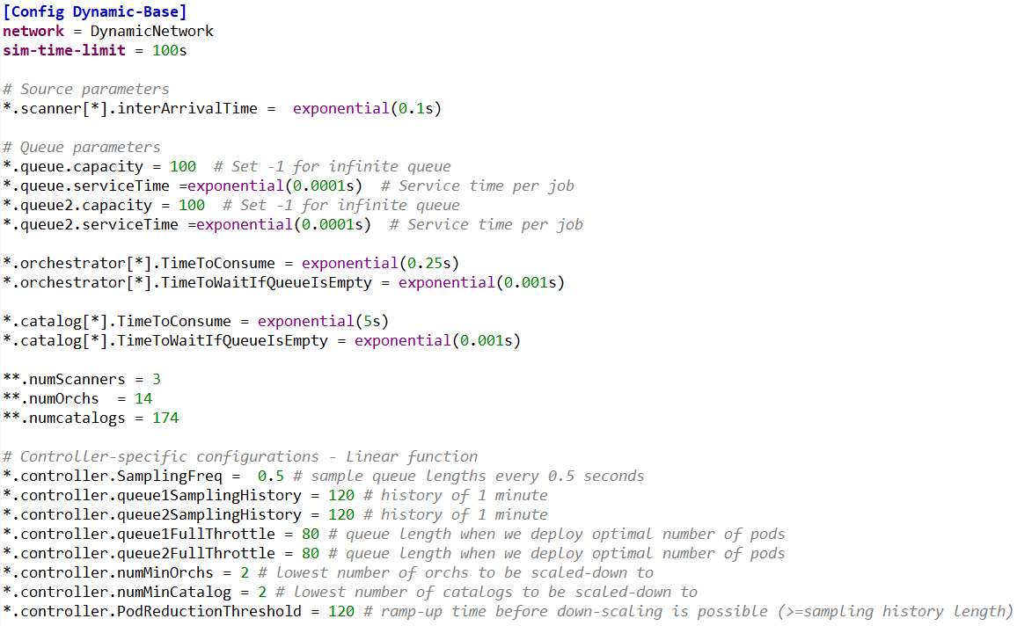
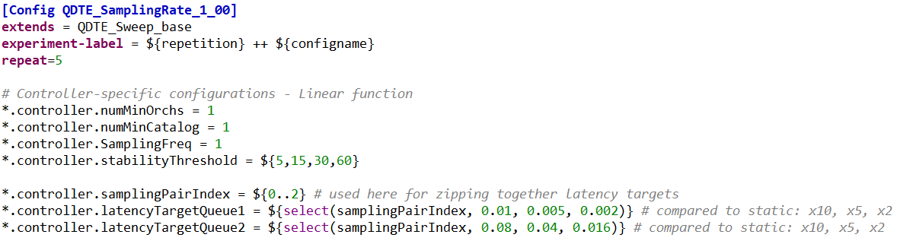
Simulation Configuration
Base config – Dynamic Simulations
Queue
Scanner
Controller
Config
Orchestrator & Catalog
Stats Collector
17 configurations
7 for static simulations
10 for dynamic simulations
Scenario-specific config

Slide 17
Statistics Collection
Queue
Scanner
Controller
Config
Orchestrator & Catalog
Stats Collector
Statistics are gathered on 13 different variables
Overall latency
# of generated, completed and dropped jobs
Their ratios are calculated within StatsCollector
Queue latencies
Queue lengths
# of enabled Orchestrators/Catalogs
Uptime of Orchestrator/Catalog pods (individually & collectively)
# of control messages sent (Dynamic simulations)
28 parameters, defining the functionality of the simulation

Slide 18
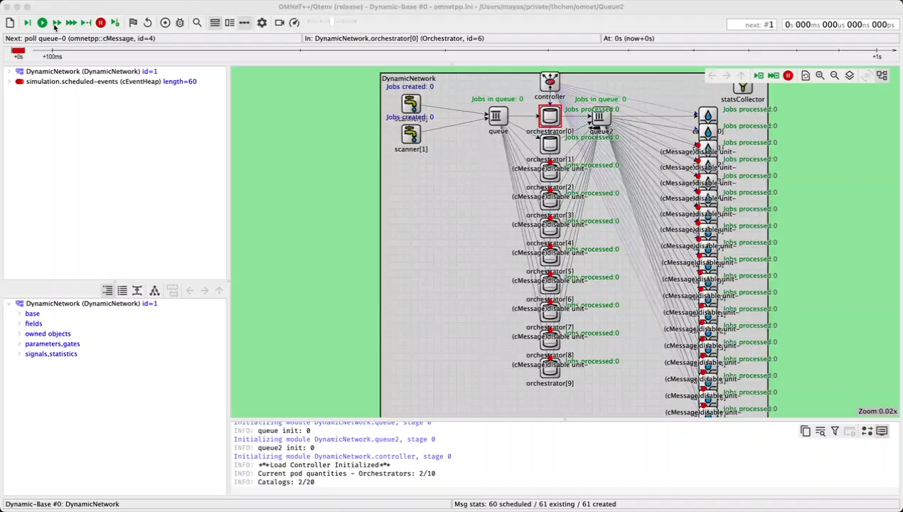
Video of the simulation

Slide 19
Static Simulation Results
d

Slide 20
Static Simulation Settings
Conditions
~3 hours simulations
Normal load: 3 active Scanner modules
Heavy load: 5 active Scanner modules
Initial sweep to find area of interest
Fine-tune sweep to locate optimal candidates
Test candidates across multiple seeds
Repeat for second queue

Slide 21
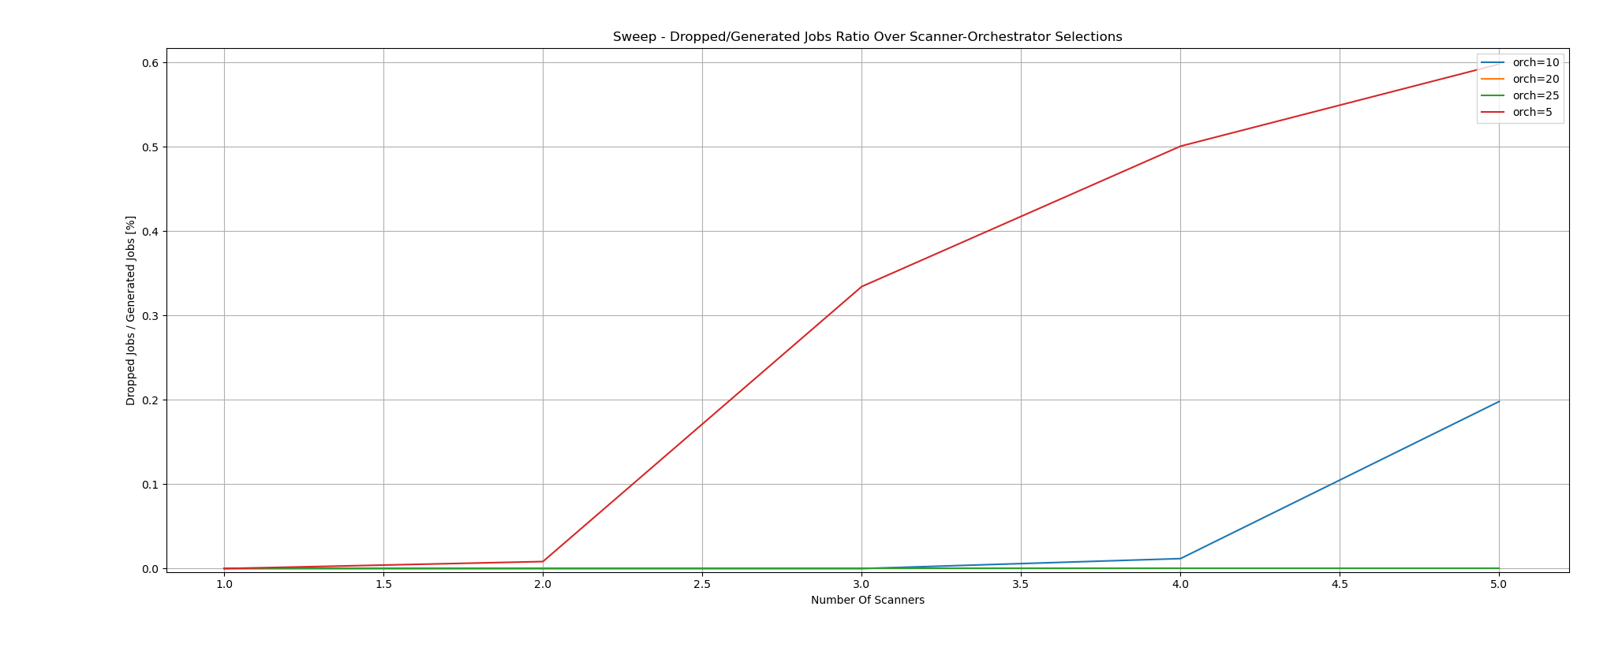
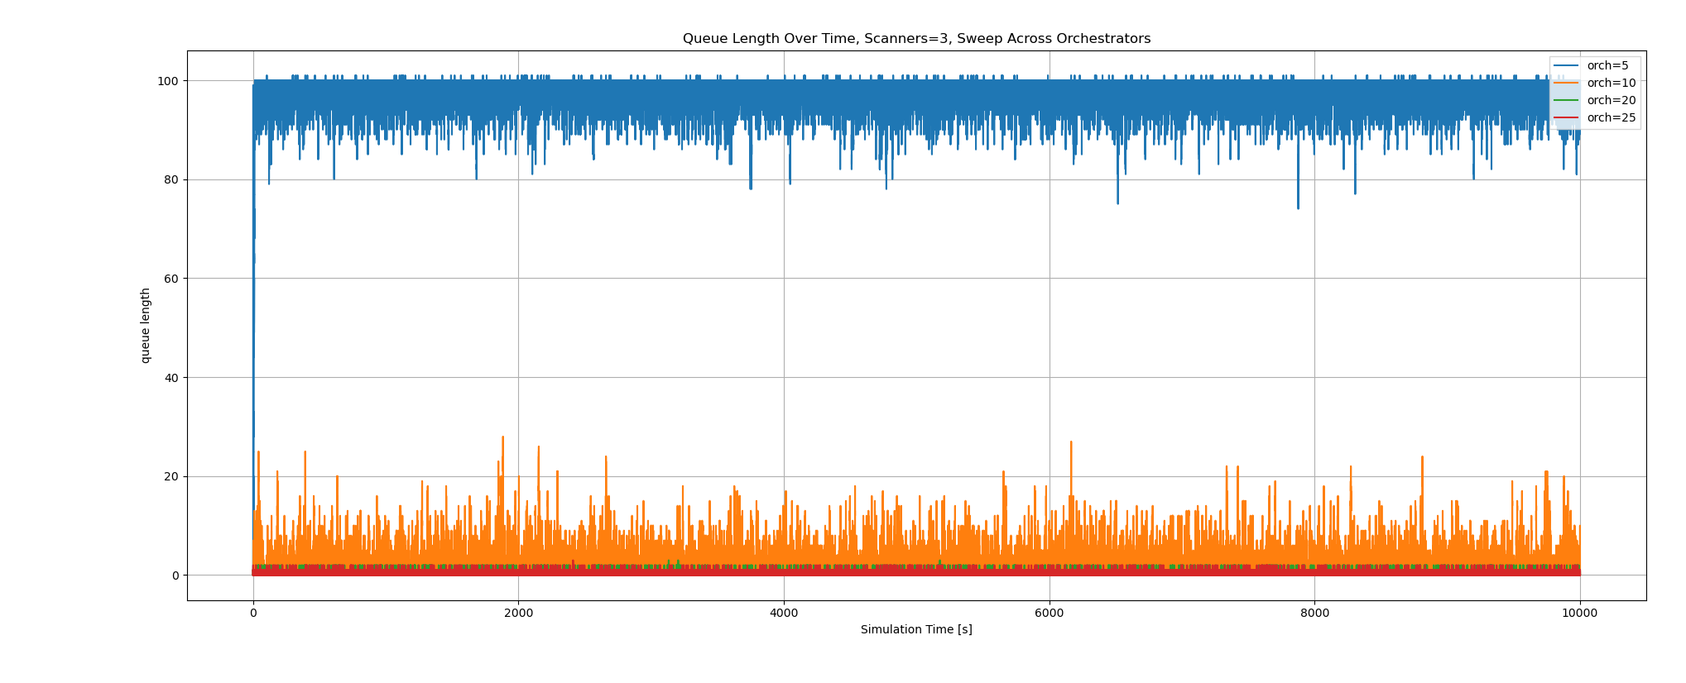
Static Sim. - Normal Load
Initial sweep
Drop-rate & queue length contained for 10-15 Orchestrators

Slide 22
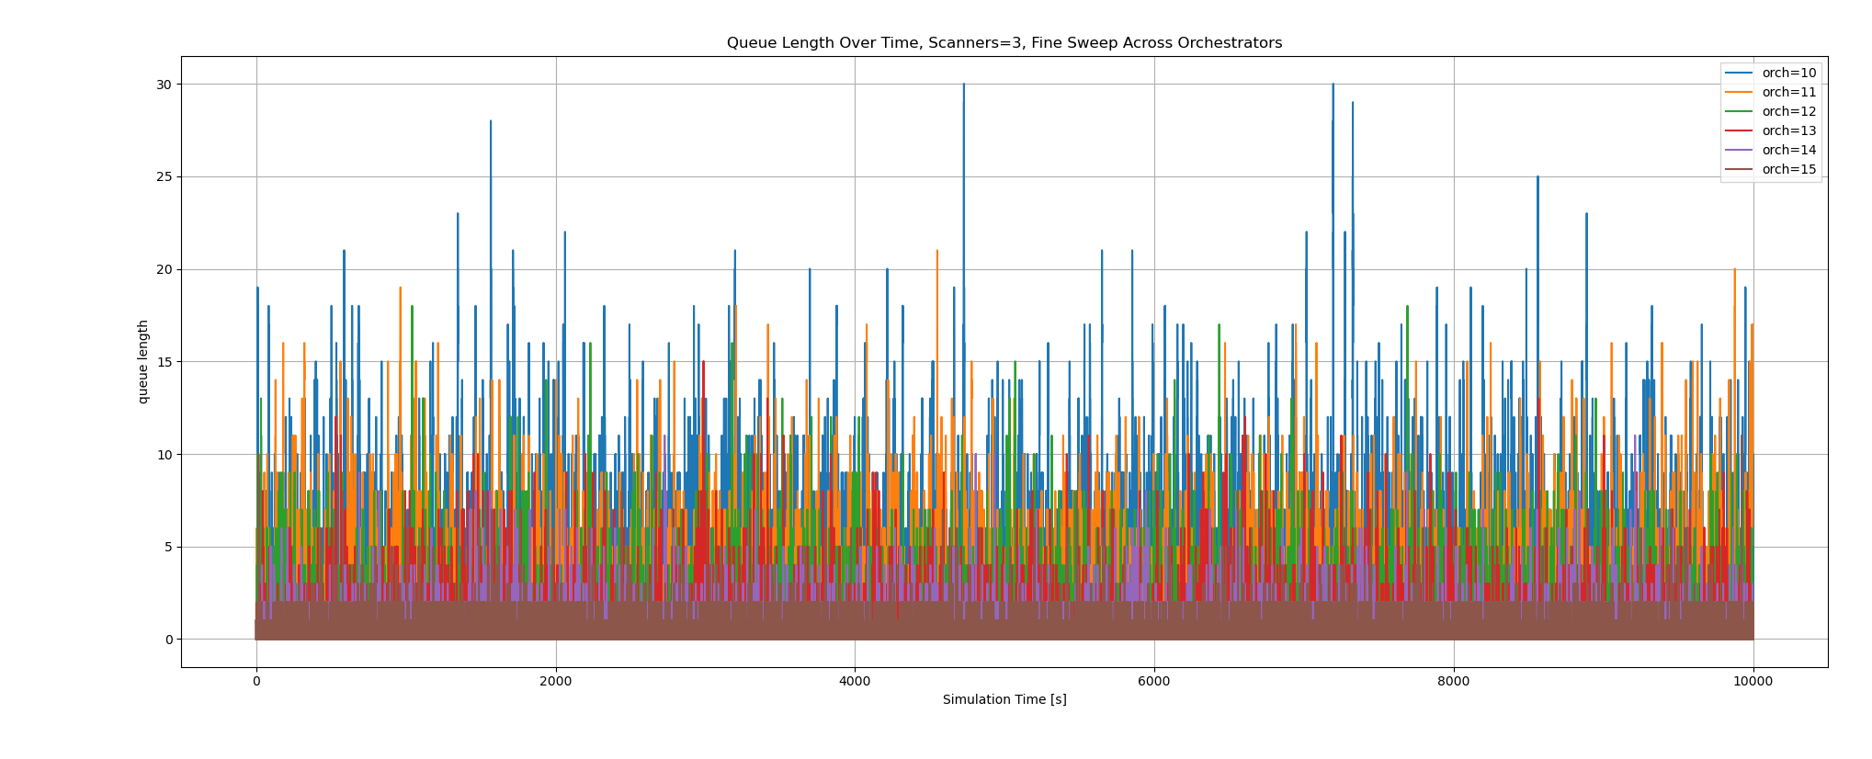
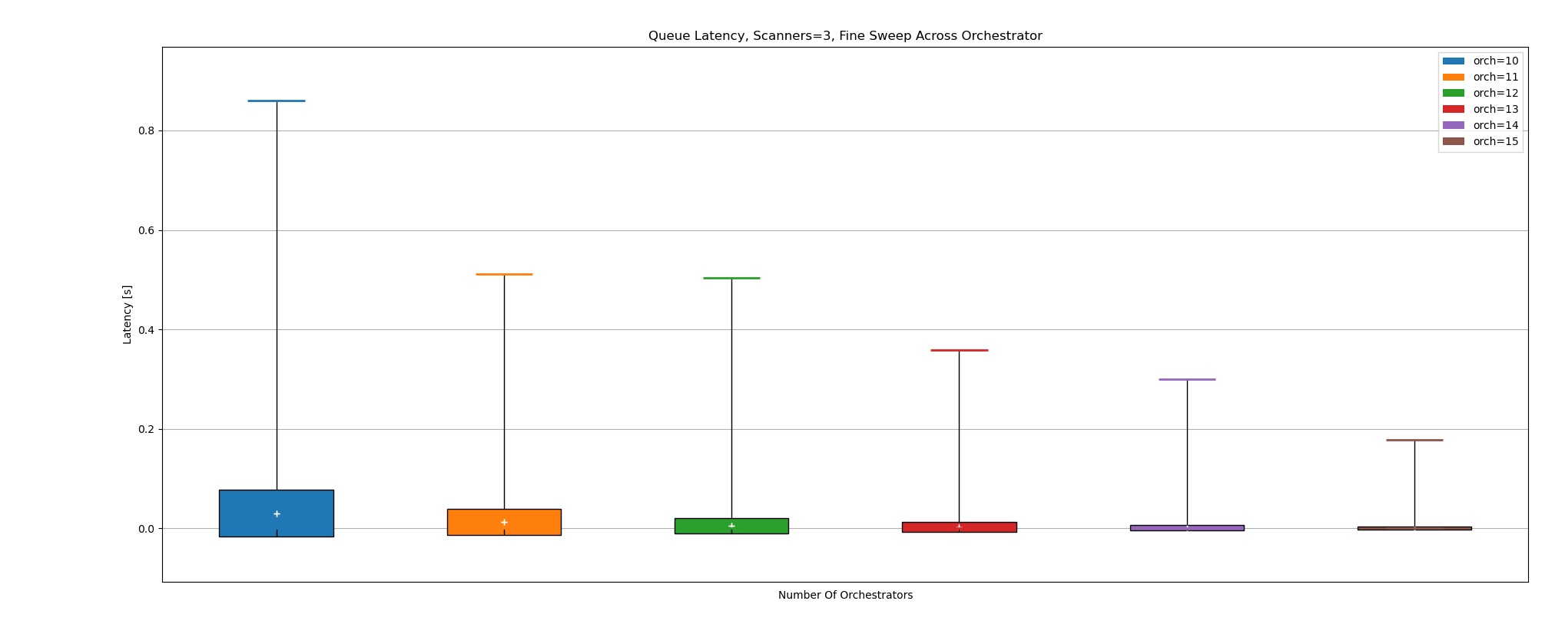
Static Sim. - Normal Load
11 Orch. Suffice for stability
Significant latency improvements
13 Orch. Improve average latency 4.7x
14 orch. By 11.2x (2.4x for one unit increase)

Slide 23
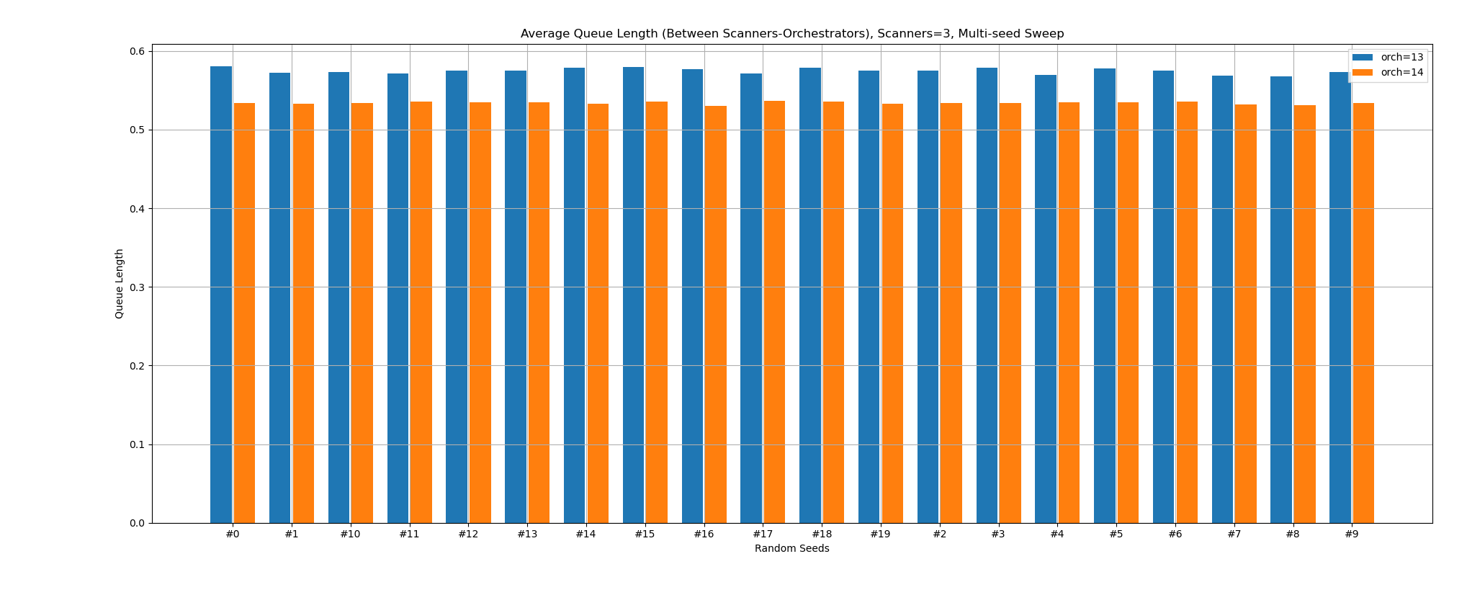
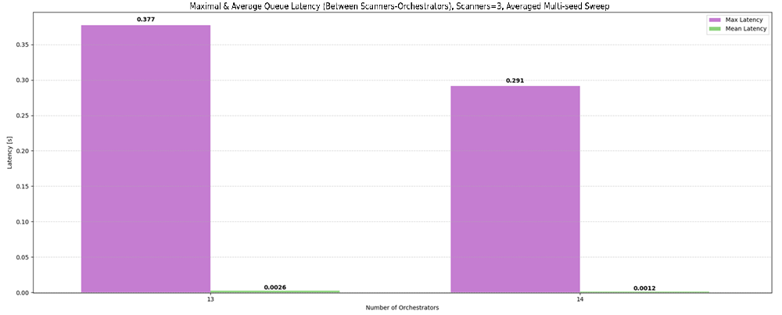
Static Sim. - Normal Load
Multi-seed testing – 13 vs 14 Orchestrators

Slide 24
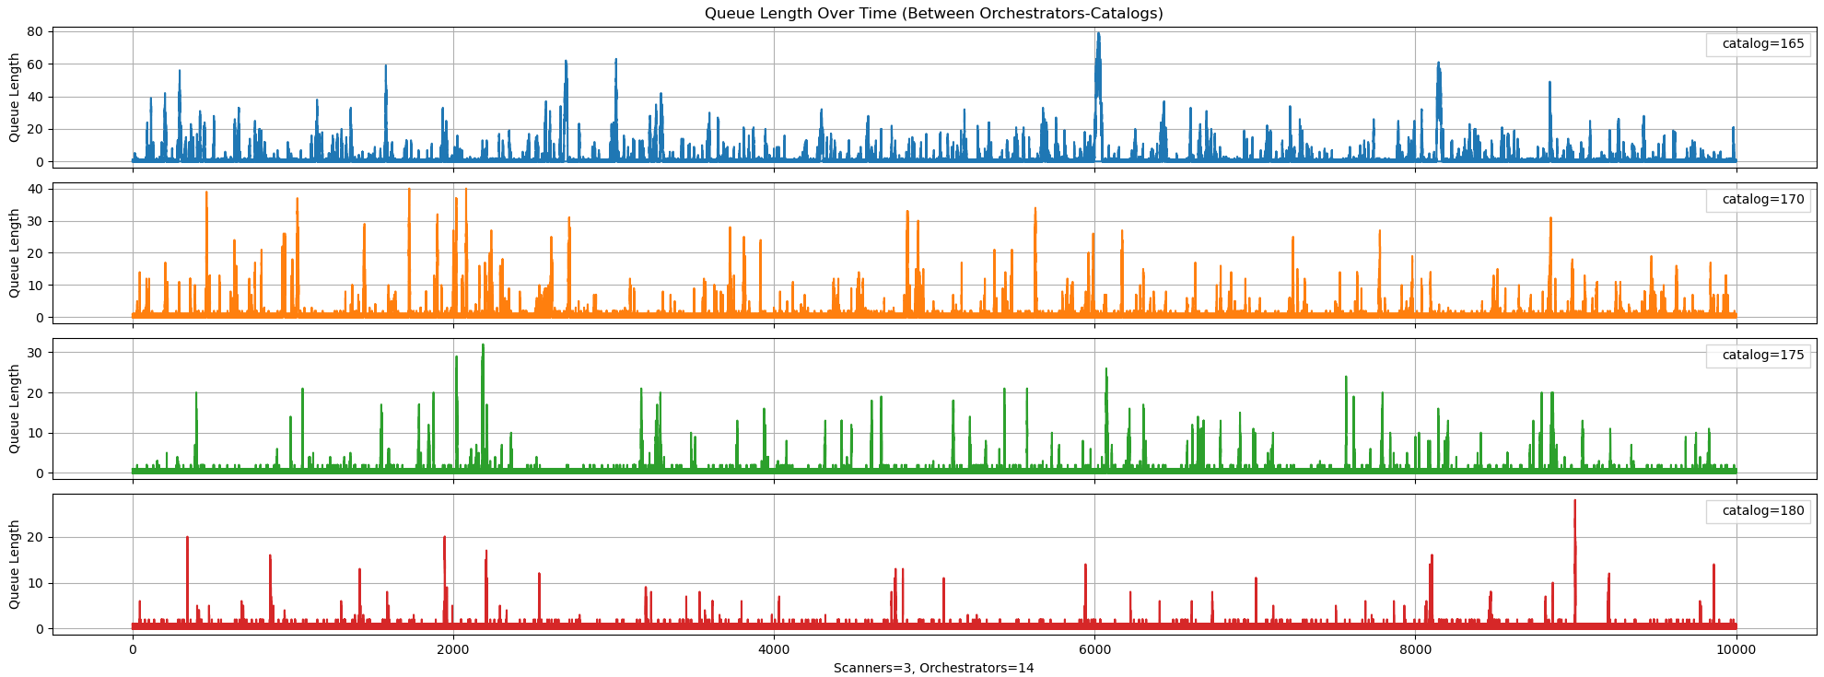
Static Sim. - Normal Load
2nd queue balancing

Slide 25
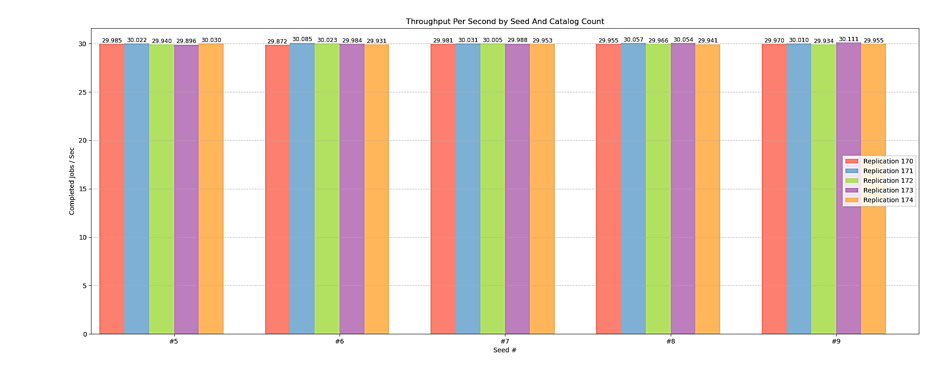
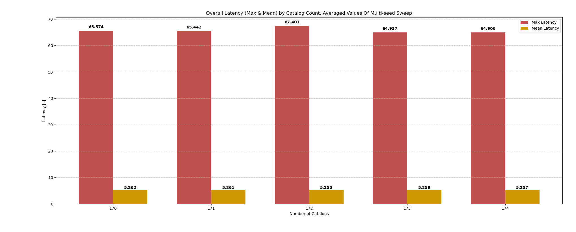
Static Sim. - Normal Load
Maximal latency is lowest with 174 catalogs
Throughput is stable for all contenders (30/sec)
Average latency stagnates – differences are up to stochastic error

Slide 26
Dynamic Simulation Results
d

Slide 27

Dynamic Simulation Settings
1-hour simulations
For each function (Linear, QDTE) - Parameter sweep to find best combination
Run each combination 5 times (different seeds), average results
Normalize results between 0-1
1 – best result in sweep
0 – worst result in sweep
Designate a score to the result of each parameter combination
$$0.2⋅\left(max latency\right)+1⋅\left(avg. latency\right)+0.5⋅\left(avg. orch num\right)+0.5⋅\left(avg. catalog num\right)+0.25⋅\left(throughput\right)+0.2⋅\left(avg. queues length\right)+0.3⋅\left(drop rate\right)+ \\ 0.25⋅\left(control messages\right)$$
Pick best combination from each function

Slide 28
Dynamic Simulation Settings
Linear Ramp-up, Averaged Decay
Minimal pod count - 1
Maximal Orch. count – 14
Maximal Catalog count – 174
Queue thresholds – 75,85,100
Sampling history – 15,30,60 sec
Sampling rate – 0.25,0.5,1 sec
Queue Drain-Time Estimation
Minimal pod count – 1
Maximal Orch. count – 14
Maximal Catalog count – 174
Target latency – 2x/5x/10x (vs static results)
Stability thresholds – 5,15,30,50 sec
Sampling rate – 0.25,0.5,1 sec

Slide 29
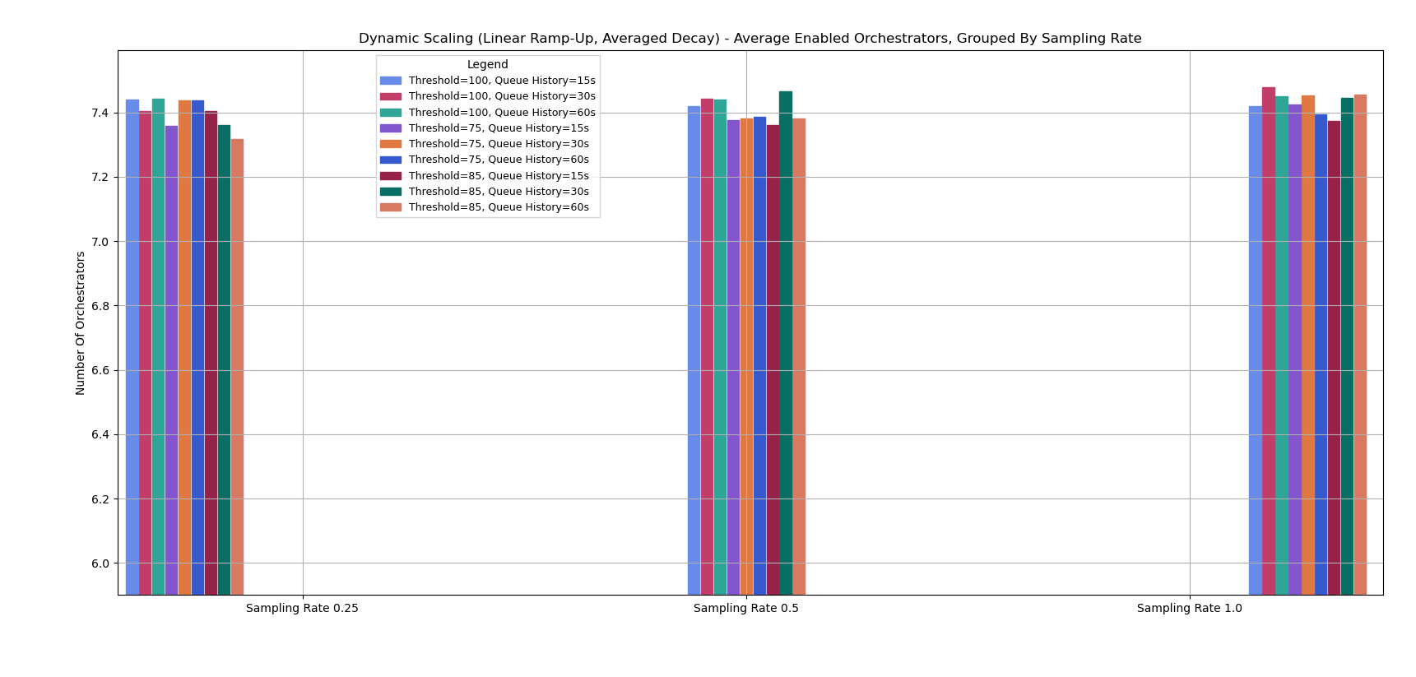
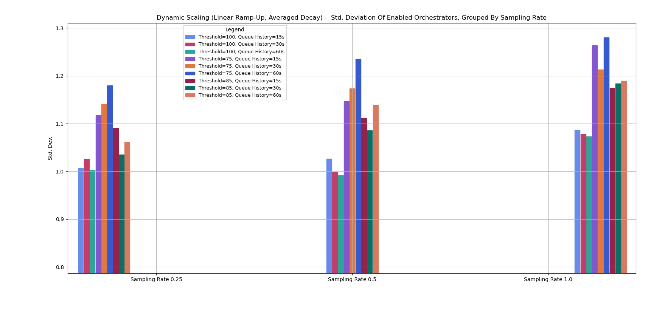
Linear Ramp-up, Averaged Decay
Most combinations stabilize on similar average value
Lowest sampling rate sees overall highest count
Standard deviation increases when sampling rate decreases
Implies stronger fluctuations in orchestrator count during the simulation
The simulation takes longer to recover after load
Nevertheless, average value is consistent among majority of combinations

Slide 30
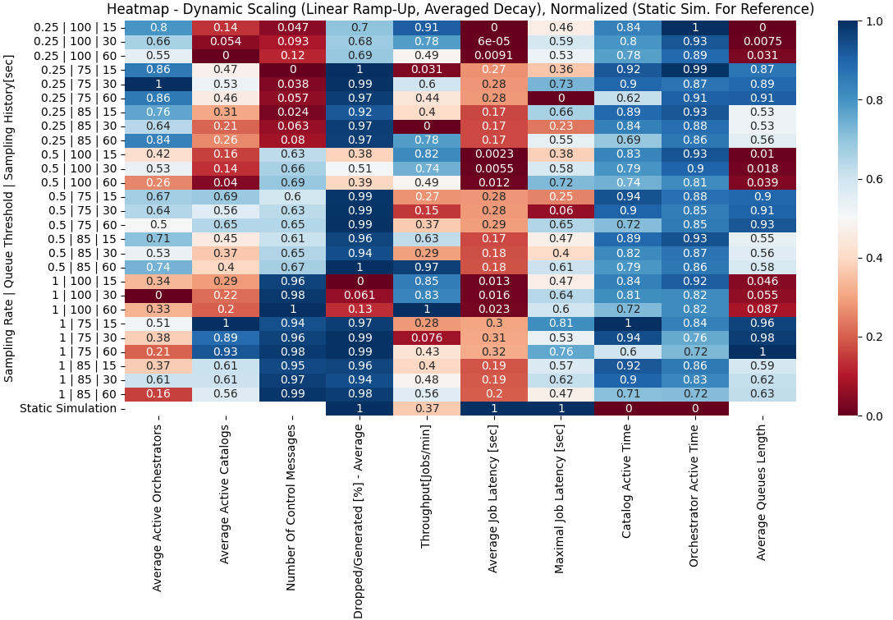
Linear Ramp-up, Averaged Decay
Drop-rate: Some combination reached 0%, majority were close (>0.95)
Throughput: Nearly all combinations surpassed result achieved by static simulation (0.37)
Latency: static sim. significantly better than any combination. Best dynamic results ere reached with lowest queue thresholds
queue length: improved with low threshold, best with slowest sampling rate
Control messages: rise with increase of sampling rate, as expected

Slide 31
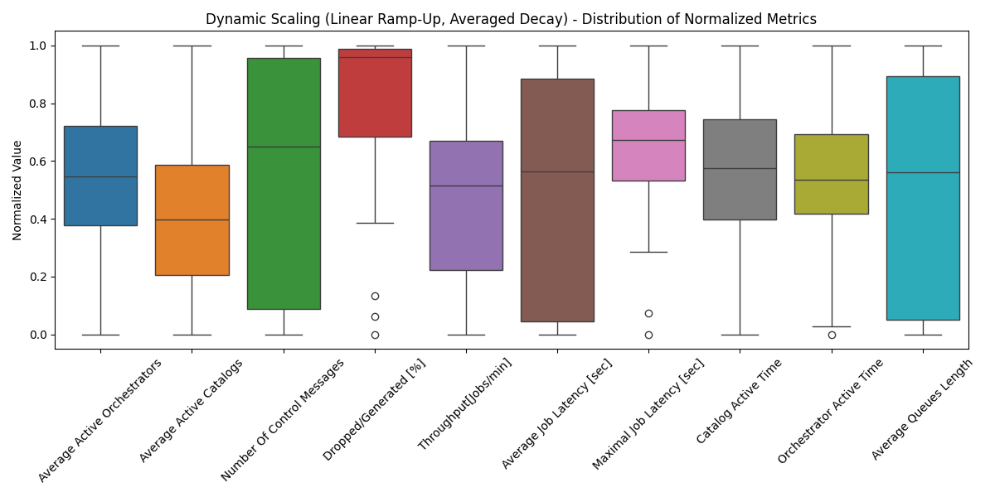
Linear Ramp-up, Averaged Decay
Large spread:
Number of control messages
Queue length
Throughput
Narrow spread:
Maximal latency
Active time
Good general result:
drop-rate
Bad general result:
Active catalog count

Slide 32
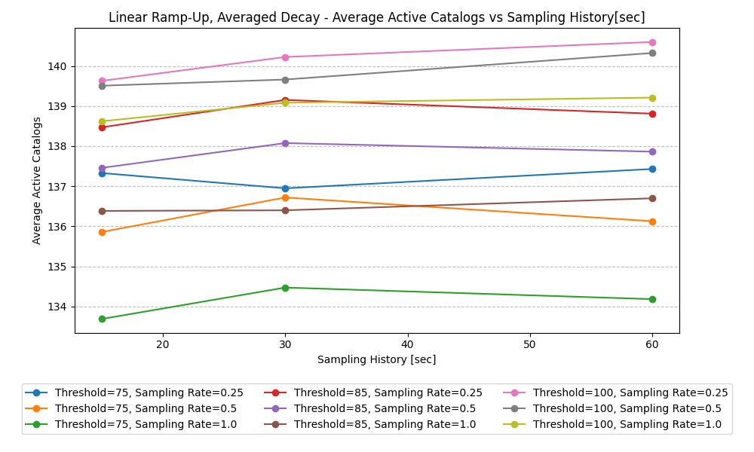
Linear Ramp-up, Averaged Decay
Lower threshold results in lower catalog count
System responds ‘in time’, spending less time with excessive units
Best results for ‘early and slow’ response -
Threshold = 75, sampling rate = 1.0

Slide 33
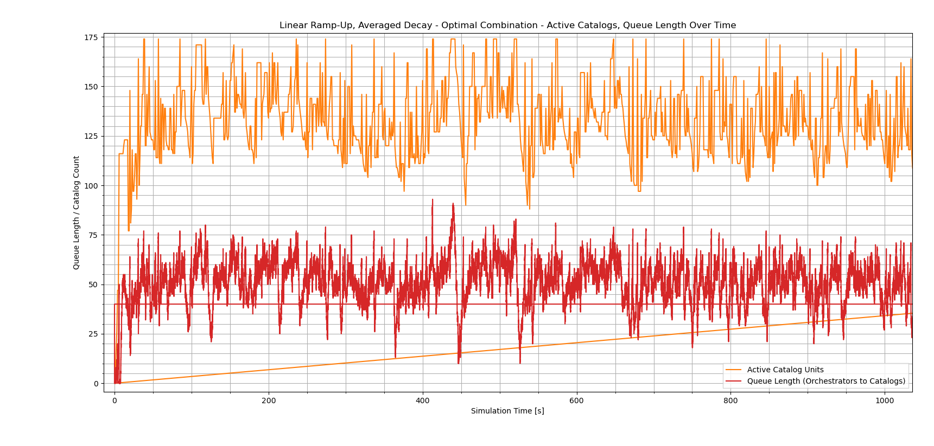
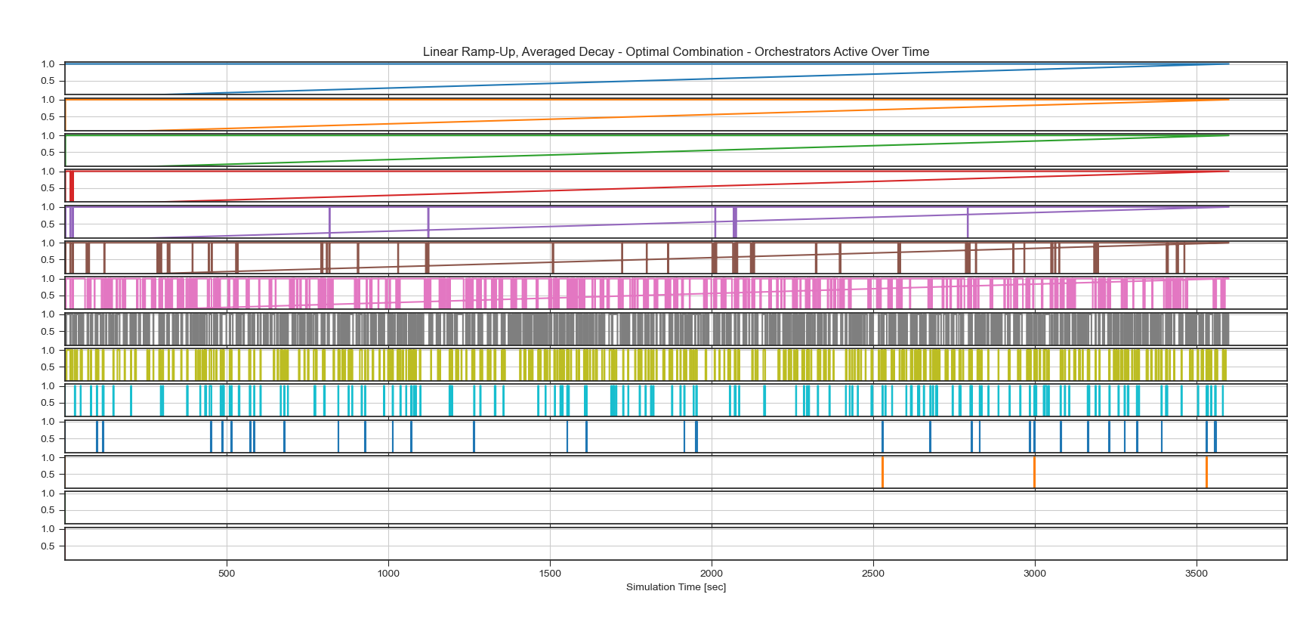
Best Combination
Best combination (score of 2.815 out of 3.2)
Queue threshold 75
Sampling Rate 1.0
Sampling History 15 sec

Slide 34
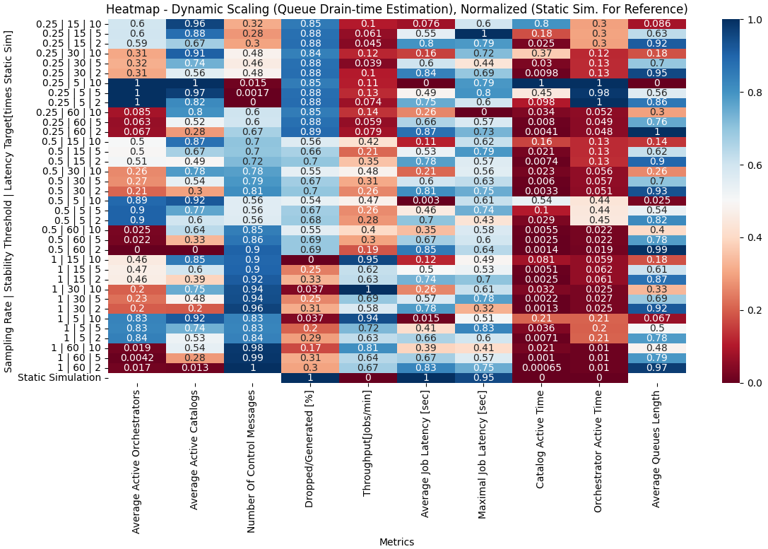
Queue Drain-Time Estimation
Throughput: all combinations achieved better results than the static simulation. best with slowest sampling rate
Drop-rate: all combinations had some drop-rate, lowest rates achieved with faster sampling rate
Latency: longer stability thresholds and fastest sampling rate achieved best results (with strictest latency target) - fastest to react, slowest to reduce
queue length & average units: impacted greatly by latency target – stricter target leads to lower queue length & higher average unit count

Slide 35
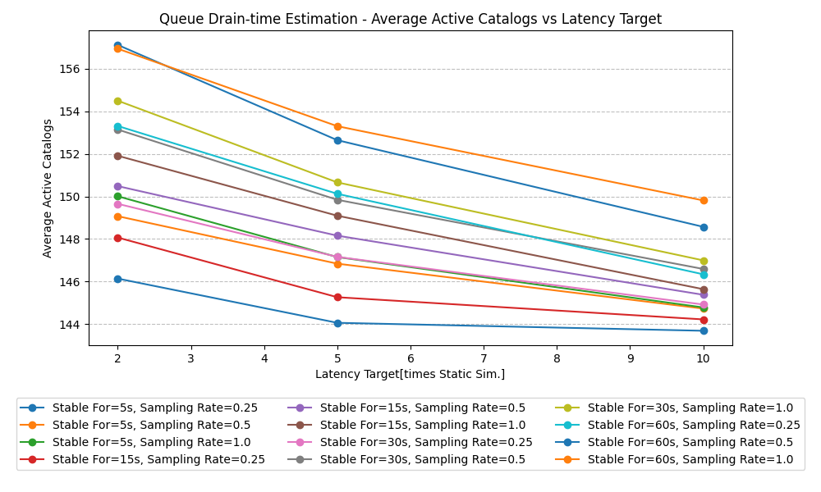
Queue Drain-Time Estimation
Impacted greatly by latency target
Faster sampling rates improve results
Longer stability threshold causes higher catalog count, albeit with lower impact than other parameters

Slide 36
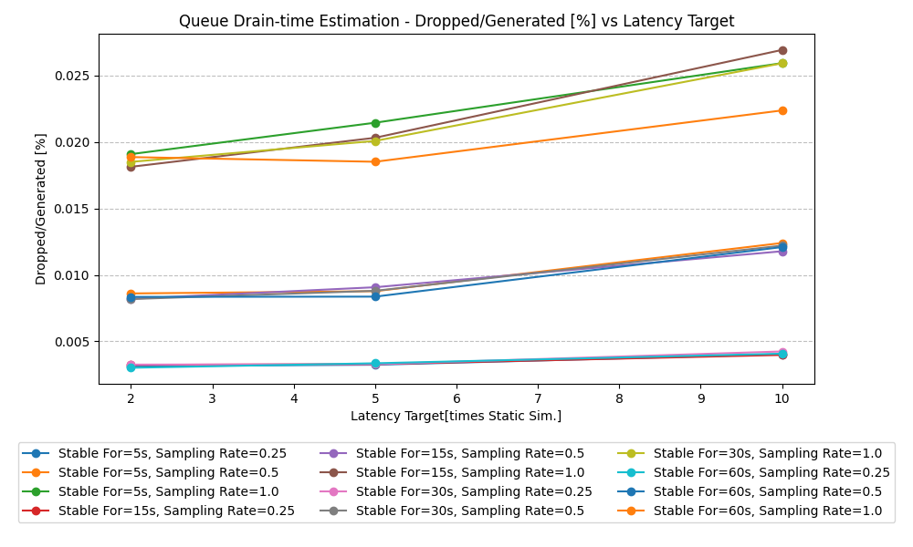
Queue Drain-Time Estimation
Impact by the system’s response time (sampling rate & stability threshold)
Lowest stability thresholds (5 sec) resulted in highest drop-rates – the system struggles to react in time to load surges
Starts with minimal unit count - most drops occur in the initial ramp-up

Slide 37
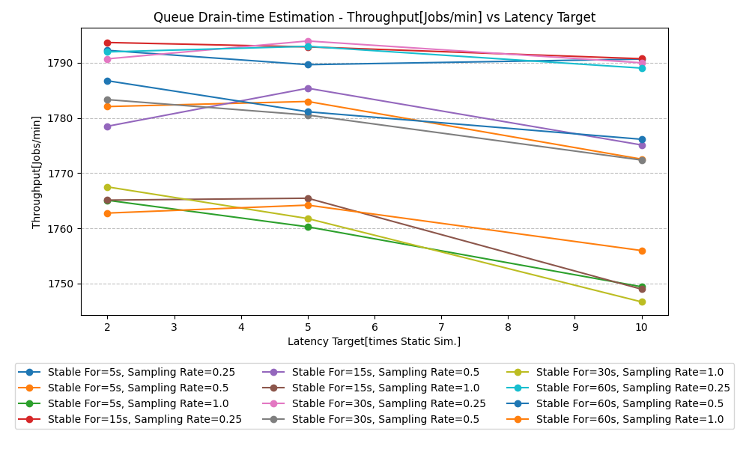
Queue Drain-Time Estimation
Sampling rate is the main factor
Best throughput achieved for 4 samples/sec
As expected, loose latency target results in lower throughputs
Best combination (score of 2.602 out of 3.2)
Sampling rate of 0.25
Stability threshold of 5 sec
Strictest latency target – 2x static sim.

Slide 38
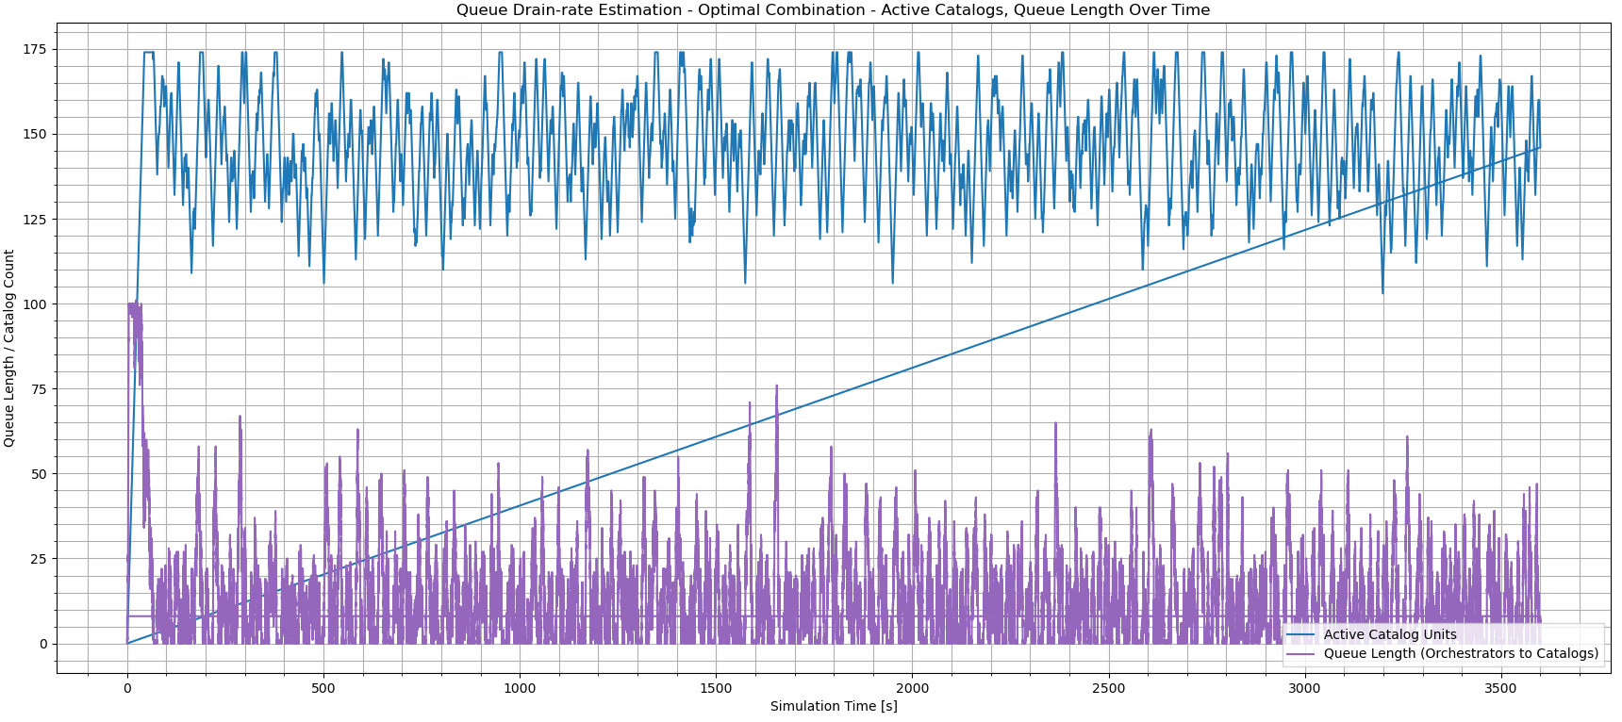
Best Combination
Sampling rate - 0.25
Stability threshold - 5 sec
Strictest latency target – 2x static sim.

Slide 39
Conclusions
d

Slide 40
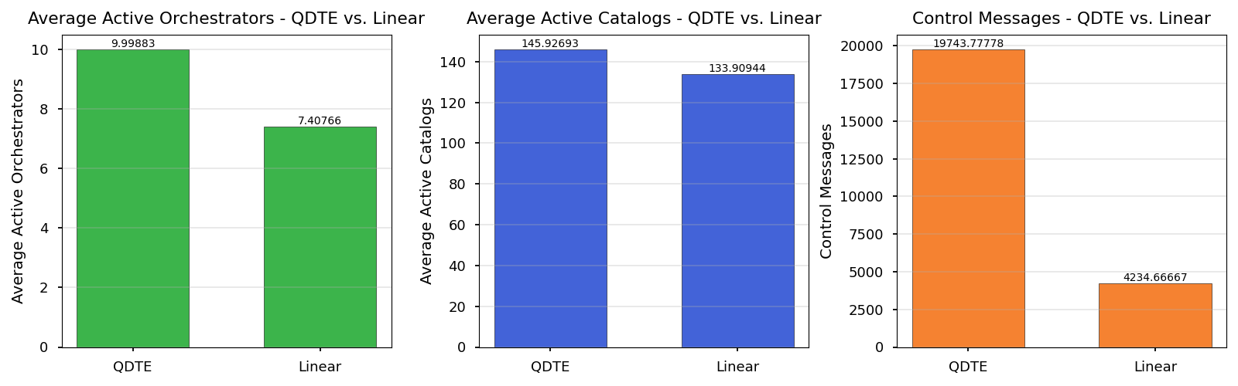
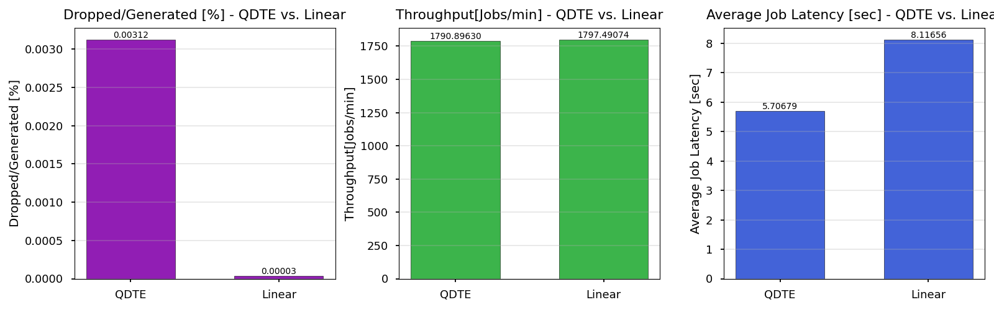
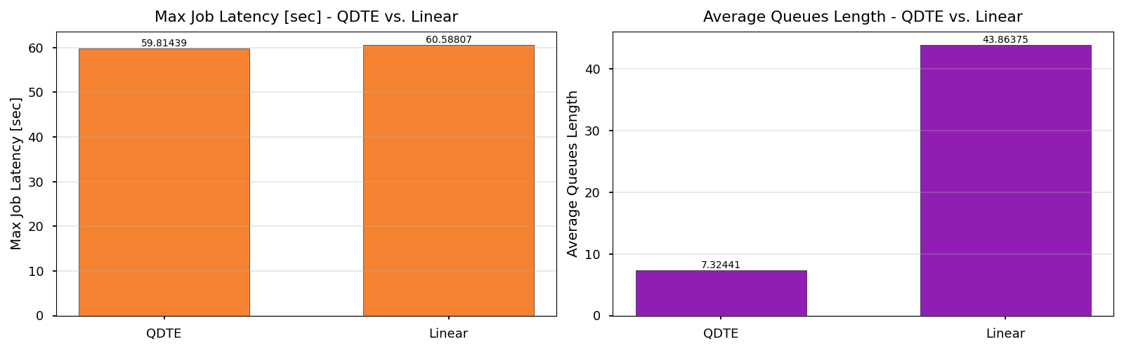
Comparing Dynamic Simulations
Sweep over 10 seeds, averaged results
No clear winner
QDTE
30% better latency
6x lower average queue length
Linear
-10% less units
4.6x less control messages
No dropped jobs
-1 sec maximal latency

Slide 41
Static Vs. Dynamic
In the real-world problem, each unit costs 337$/month
Both dynamic simulations use significantly less units than static simulation (188 units)
Optimal linear function – 142 units on average → 15,502$ saved per month
Optimal QDTE function – 156 units on average → 10,784$ saved per month
Focusing solely on cost reduction – linear function wins clearly
If latency is of importance – QDTE serves as a good solution

Slide 42
Conclusions
We learned how to use OMNeT++ to build & run complex simulations, collect various statistics and extract insights about the system’s behavior
Since the simulator requires writing in C++, we had to learn and improve our skills in the language, some of us weren’t familiar with before the project
In the static simulation, we found the stable states for the system under different loads, with low latency and no dropped jobs – just like we’d want in the real system
We built a dynamic control mechanism, tested 2 approaches using parameter sweeps to achieve optimal results

Slide 43

Thank You!

